Slide 1

CS 560: Software Engineering
Introduction
Dr. Mohammed Ayoub Alaoui Mhamdi
Bishop's University
Sherbrooke, Qc, Canada
malaoui@ubishops.ca

Slide 2
ARIANE Flight 501
Disintegration after 39 sec
Caused by large correction for attitude deviation
Caused by wrong data being sent to On Board Computer
Caused by software exception in Inertial Reference System after 36 sec.
Faculty of Arts and Science

Slide 3
The details
Overflow in conversion of variable BH from 64-bit floating point to 16-bit signed integer
Of 7 risky conversions, 4 were protected; BH was not
Reasoning: physically limited, or large margin of safety
In case of exception: report failure on databus and shut down
Faculty of Arts and Science

Slide 4
Possible explanations
Inadequate testing
Wrong type of reuse
Wrong design philosophy
Faculty of Arts and Science

Slide 5
Inadequate testing?
Specification does not contain Ariane 5 trajectory data as a functional requirement
In tests, the SRI’s (components that measure altitude and movements of the launcher) were simulated by software modules
Faculty of Arts and Science

Slide 6
Improper reuse?
If a component works perfectly well in one environment, it doesn’t necessarily do so in another
Ariane 5 is much faster than Ariane 4, and horizontal velocity builds up more rapidly
⇒ excessive values for parameter in question
Wish for quick alignment after hold in shutdown
⇒ this software runs for a while after lift-off. It doesn’t have any purpose for the Ariane 5, but was still kept
Faculty of Arts and Science

Slide 7
Wrong design philosophy?
If something breaks down, such is caused by a random hardware failure
Action: shut down that part
There is no provision for design errors
Faculty of Arts and Science

Slide 8
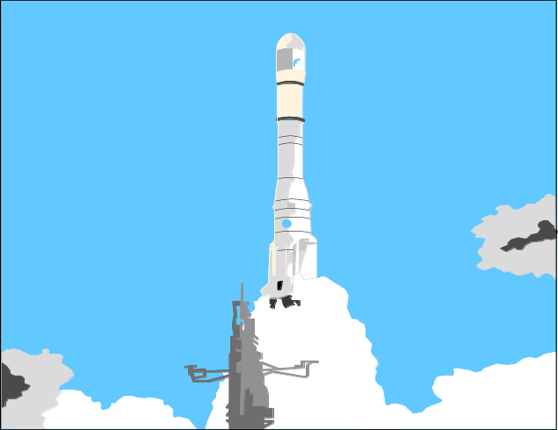
Further information:
IEEE Computer, jan. 1997, p. 129-130
http://www.cs.vu.nl/~hans/ariane5report.html
Faculty of Arts and Science

Slide 9
Software engineering
The beginning
1968/69 NATO conferences: introduction of the term Software Engineering
Idea: software development is not an art, or a bag of tricks
Build software like we build bridges
Faculty of Arts and Science

Slide 10
Current status
a lot has been achieved
but …
some of our bridges still collapse
Faculty of Arts and Science

Slide 11
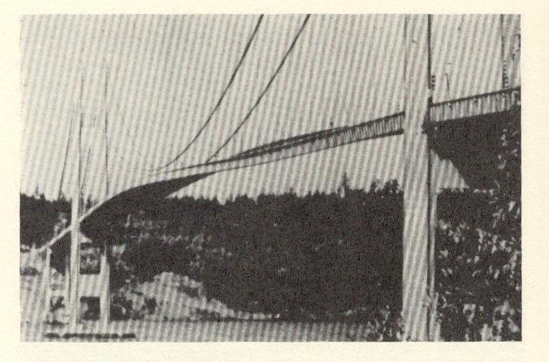
Tacoma Narrows bridge
Faculty of Arts and Science

Slide 12
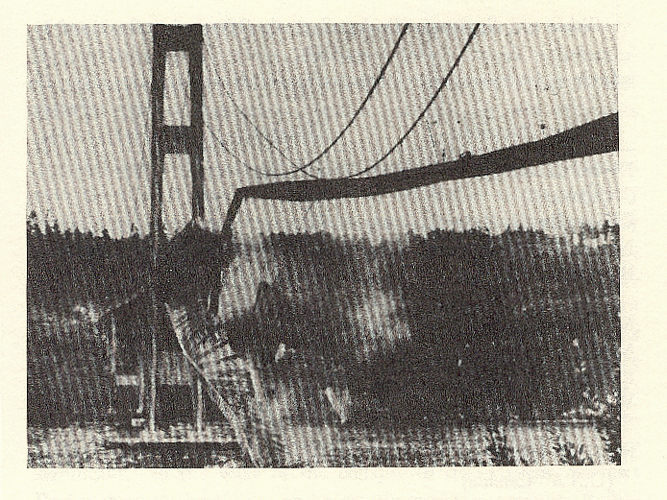
Same bridge, a while later
Faculty of Arts and Science

Slide 13
Further references
Henry Petroski, Design Paradigms: Case Histories of Error and Judgement in Engineering
A. Spector & D. Gifford, A Computer Science Perspective of Bridge Design, Comm. Of the ACM 29, 4 (1986) p 267-283
Faculty of Arts and Science

Slide 14
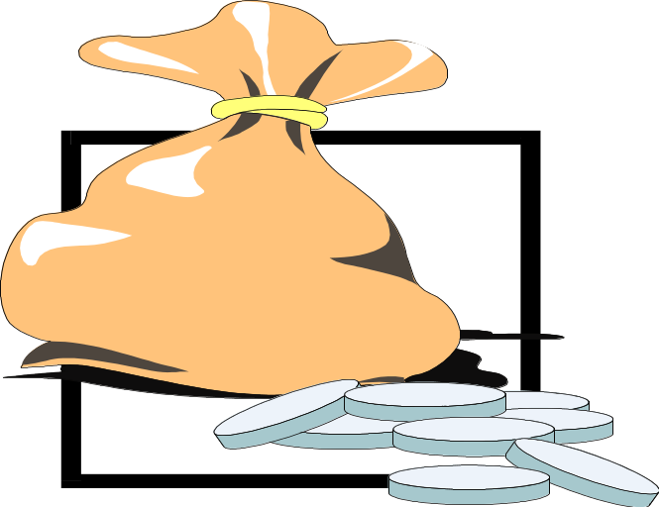
Physical systems vs. Software
Which one of them does cost most in the presence of an error?
Why?
Faculty of Arts and Science

Slide 15
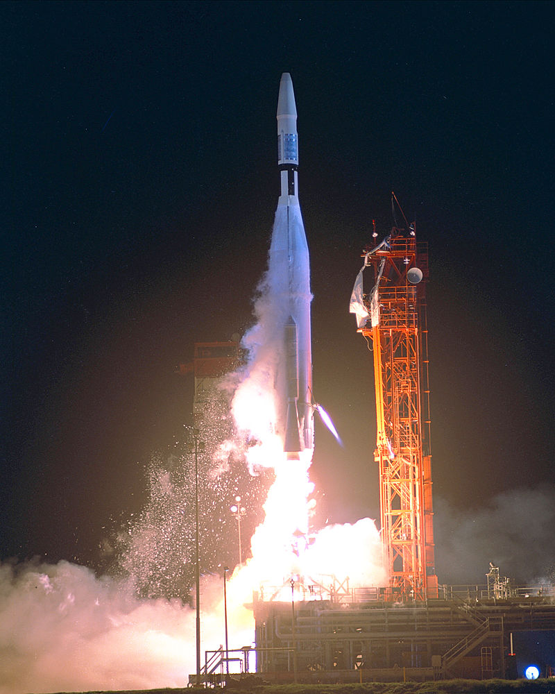
Mariner 1
Was the first spacecraft of the American Mariner program, designed for a planetary flyby of Venus.
It cost $18.5 million in 1962.
It was launched aboard an Atlas-Agena rocket on July 22nd, 1962.
Faculty of Arts and Science

Slide 16
Mariner 1
The Mariner space rocket to Venus for example got lost because of a typing error in a FORTRAN program.
  a period typed in place of a comma, causing a FORTRAN DO loop statement to be misinterpreted,
  a missing comma
  an extraneous semicolon
Faculty of Arts and Science

Slide 17
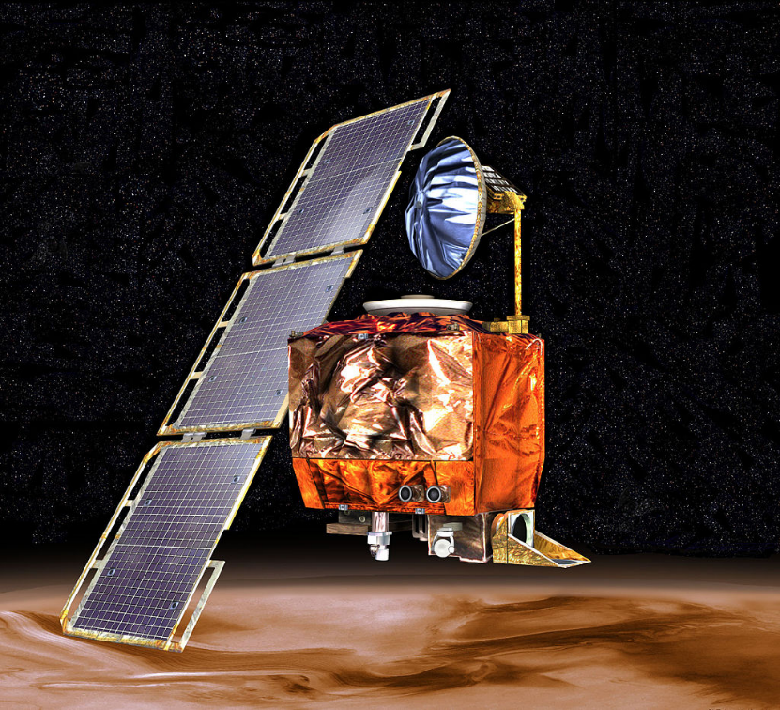
Mars Climate Orbiter accident
The Mars Climate Orbiter was a robotic space probe launched by NASA on December 11, 1998 to study the Martian climate, Martian atmosphere, and surface changes and to act as the communications relay in the Mars Surveyor '98 program for Mars Polar Lander.
The cost was 193,1 millions USD
Faculty of Arts and Science

Slide 18
Mars Climate Orbiter accident
In 1998, the Mars Climate Orbiter got lost, because one development team used English units such as inches and feet, while another team used metric units.
Faculty of Arts and Science

Slide 19
Physical systems vs. Software
Physical systems are often continuous in the sense that small changes in the specification lead to small changes in the product.
This is not true with software.
Small changes in the specification of software may lead to considerable changes in the software itself.
In a similar way, small errors in software may have considerable effects.
Faculty of Arts and Science

Slide 20
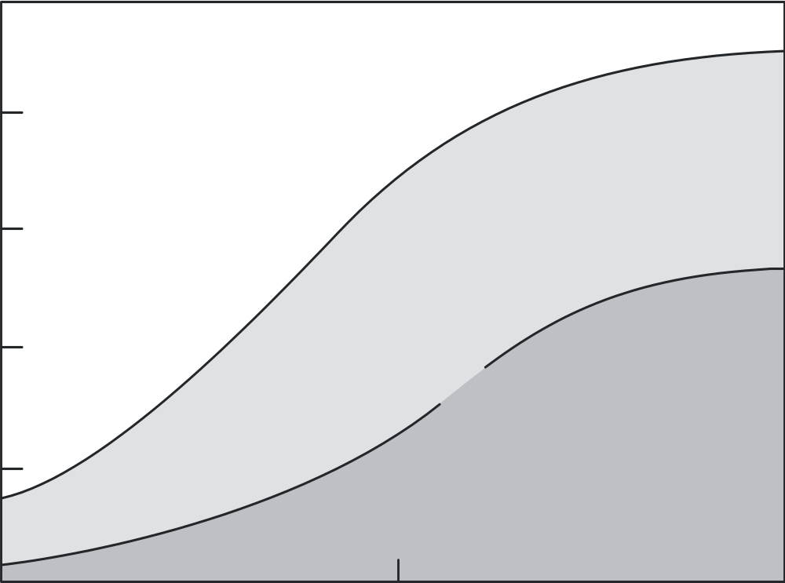
Relative distribution of software/hardware costs
100
Hardware
Development
60
Percent of total cost
Software
20
Maintenance
1955
1970
1985
Year
Faculty of Arts and Science

Slide 21
Point to ponder #1
Why does software maintenance cost so much?
Faculty of Arts and Science

Slide 22
Definition (IEEE)
Software Engineering is the application of a systematic, disciplined, quantifiable approach to the development, operation, and maintenance of software; that is, the application of engineering to software
Faculty of Arts and Science

Slide 23
Central themes
SE is concerned with BIG programs
complexity is an issue
software evolves
development must be efficient
you’re doing it together
software must effectively support users
involves different disciplines
SE is a balancing act
Faculty of Arts and Science

Slide 24
Building software ~ Building bridges?
yes, and no
software is logical, rather than physical
progress is hard to see (speed ≠ progress)
software is not continuous
Faculty of Arts and Science

Slide 25
Simple life cycle model
problem
requirements engineering
reqs specification
design
design
implementation
system
testing
working system
maintenance
Faculty of Arts and Science

Slide 26
Point to ponder #2
Is this a good model
of how we go about?
of how we should go about?
Faculty of Arts and Science

Slide 27
Requirements Engineering
yields a description of the desired system:
  which functions
  possible extensions
  required documentation
  performance requirements
includes a feasibility study
resulting document: requirements specification
Faculty of Arts and Science

Slide 28
Design
earliest design decisions captured in software architecture
decomposition into parts/components; what are the functions of, and interfaces between, those components?
emphasis on what rather than how
resulting document: specification
Faculty of Arts and Science

Slide 29
Implementation
focus on individual components
goal: a working, flexible, robust, … piece of software
not a bag of tricks
present-day languages have a module and/or class concept
Faculty of Arts and Science

Slide 30
Testing
does the software do what it is supposed to do?
are we building the right system? (validation)
are we building the system right? (verification)
start testing activities in phase 1, on day 1
Faculty of Arts and Science

Slide 31
Maintenance
correcting errors found after the software has been delivered
adapting the software to changing requirements, changing environments, ...
Faculty of Arts and Science

Slide 32
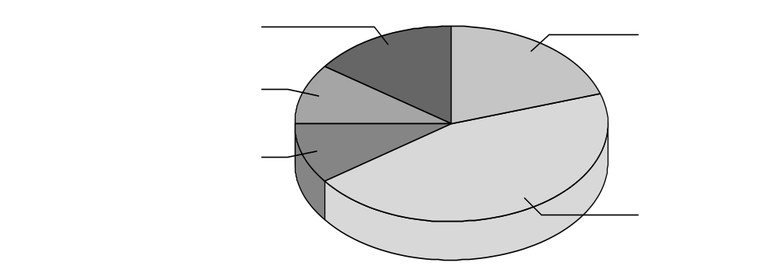
Global distribution of effort
design 15%
coding 20%
requirements
engineering 10%
specification 10%
testing 45%
Faculty of Arts and Science

Slide 33
Global distribution of effort
rule of thumb: 40-20-40 distribution of effort
  only 20% of the effort is spent on actually programming (coding) the system, while the preceding phases (requirements engineering and design) and testing each consume about 40% of the total effort.
trend: enlarge requirements specification/design slots; reduce test slot
beware: maintenance alone consumes 50-75% of total effort
Faculty of Arts and Science

Slide 34
Kinds of maintenance activities
corrective maintenance: correcting errors
adaptive maintenance: adapting to changes in the environment (both hardware and software)
perfective maintenance: adapting to changing user requirements
Faculty of Arts and Science

Slide 35
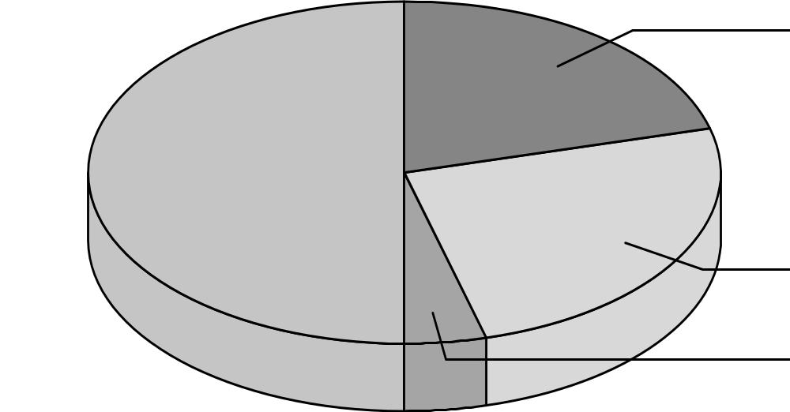
Distribution of maintenance activities
corrective 21%
perfective 50%
adaptive 25%
preventive 4%
Faculty of Arts and Science

Slide 36
Point to ponder #3
You are a tester, and the product you are testing does not yet meet the testing requirements agreed upon in writing. Your manager wants to ship the product now, continue testing so that the next release will meet the testing requirements. What do you do?
Discuss the issue with your manager?
Talk to the manager’s boss?
Talk to the customer?
Faculty of Arts and Science

Slide 37
Software Engineering Ethics - Principles
Act consistently with the public interest
Act in a manner that is in the best interest of the client and employer
Ensure that products meet the highest professional standards possible
Maintain integrity in professional judgment
Managers shall promote an ethical approach
Advance the integrity and reputation of the profession
Be fair to and supportive of colleagues
Participate in lifelong learning and promote an ethical approach
Faculty of Arts and Science

Slide 38
Recent developments
Rise of agile methods
Shift from producing software to using software
Success of Open Source Software
Software development becomes more heterogeneous
Faculty of Arts and Science

Slide 39
The Agile Manifesto
Individuals and interactions over processes and tools
Working software over comprehensive documentation
Customer collaboration over contract negotiation
Responding to change over following a plan
Faculty of Arts and Science

Slide 40
Producing software ⇒ Using software
Builders build pieces, integrators integrate them
Component-Based Development (CBSD)
Software Product Lines (SPL)
Commercial Off-The-Shelves (COTS)
Service Orientation (SOA)
Faculty of Arts and Science

Slide 41
Heterogeneity异质性，不均匀性，不纯一性;
Old days: software development department had everything under control
Nowadays:
  Teams scattered around the globe
  Components acquired from others
  Includes open source parts
  Services found on the Web
Faculty of Arts and Science

Slide 42
Point to ponder #4
Which of the following do you consider as Software Engineering Principles?
  Build with and for reuse
  Define software artifacts rigorously
  Establish a software process that provides flexibility
  Manage quality as formally as possible
  Minimize software components interaction
  Produce software in a stepwise fashion
  Change is inherent, so plan for it and manage it
  Tradeoffs are inherent, so make them explicit and document them
  Uncertainty is unavoidable, so identify and manage it
Faculty of Arts and Science

Slide 43
SUMMARY
software engineering is a balancing act, where trade-offs（交易） are difficult
solutions are not right or wrong; at most they are better or worse
most of maintenance is (inevitable) evolution
there are many life cycle models, and they are all models
Faculty of Arts and Science

